Slide 1
Human-Centered Digital Twin for Dynamic Competency Management in Airport Ground Handling Operations
Rustam Togambayev & Iyad Alomar
Transport and Telecommunication Institute

Slide 2
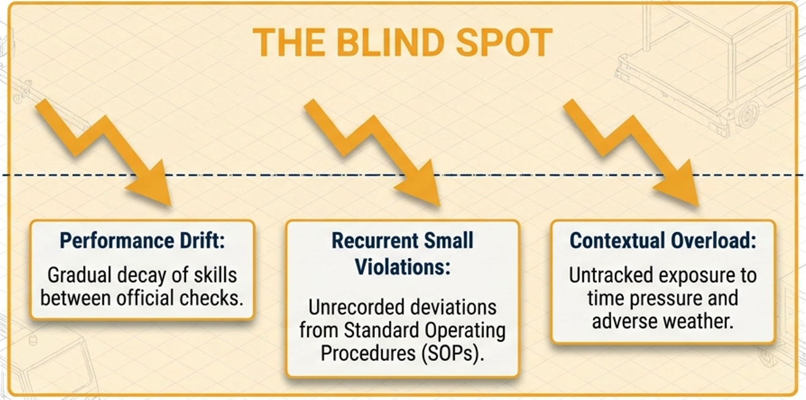
THE BLIND SPOT OF STATIC CERTIFICATION
Initial Certification
Recertification
event
The current systems are purely retrospective . They rely on audits and accidents to record deviations after they happen, falling to capture the dynamic reality of GHO.
Rustam Togambayev & Iyad Alomar

Slide 3
Objectivities
Goal: built an employee’s digital passport
Reduce Human Factor in Aviation Safety
Safe and Sustainability Ground Handling environment
To identify gaps in knowledge and pinpoint strengths and weaknesses
Determine employees’ strength and weaknesses
Transfer Certification from static to dynamic model
Long-term, continuous assessment of competences
Integrate systems and translate data to understandable metrics
Improving SOPs
Rustam Togambayev & Iyad Alomar
Notes:
Colleagues, the key objective of our project is to create a digital employee passport. To this end, we have set ourselves a number of strategic objectives. Firstly, this involves systematically reducing the human factor and improving overall safety on the platform. Secondly, we aim to move away from outdated, bureaucratic certification towards a dynamic model – the continuous, real-time monitoring of competencies. Ultimately, we will integrate disparate data systems to gain a clear picture of our staff’s strengths and weaknesses and to understand exactly which tasks on the airfield a particular employee is best suited for.

Slide 4
Gaps
Data Fragmentation
No Integration Between Real Data and Training Systems. Training outcomes are not systematically linked to operational performance
Current assessment approaches lack scalability (manual, episodic assessments), visibility (limited insight into individual performance trajectories), and risk prediction (static models cannot forecast future risk).
Rustam Togambayev & Iyad Alomar
Notes:
During reviewing a literature sources the following shortcomings were identified.

Slide 5
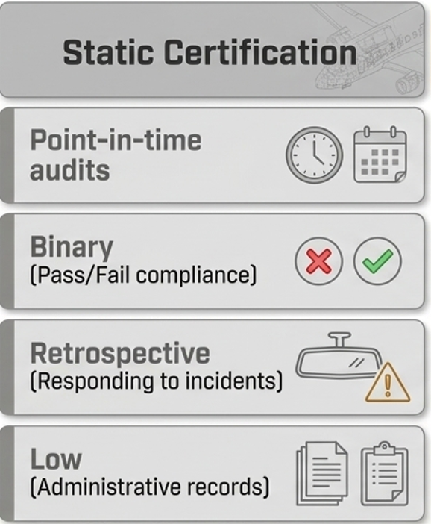
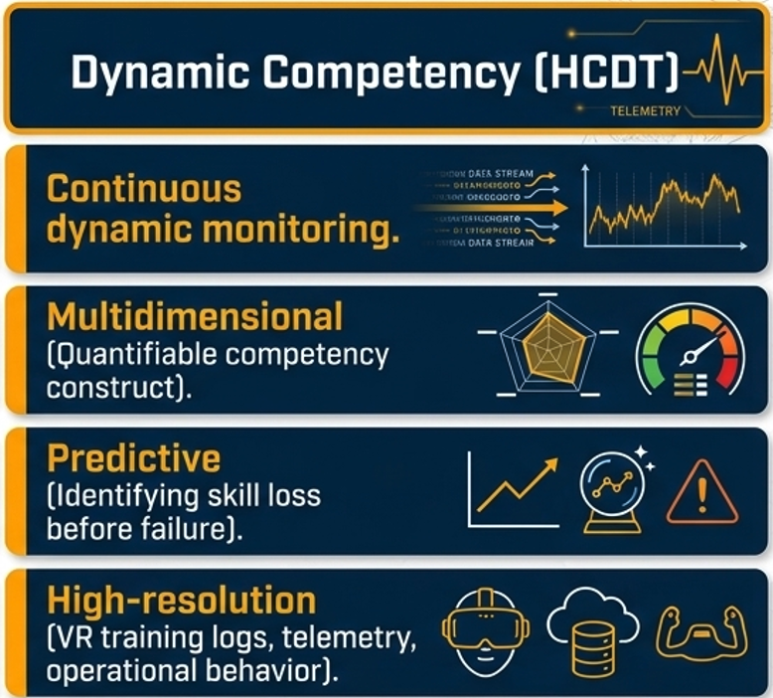
Shift Paradigms. From Compliance to Continuous Competency
Rustam Togambayev & Iyad Alomar

Slide 6
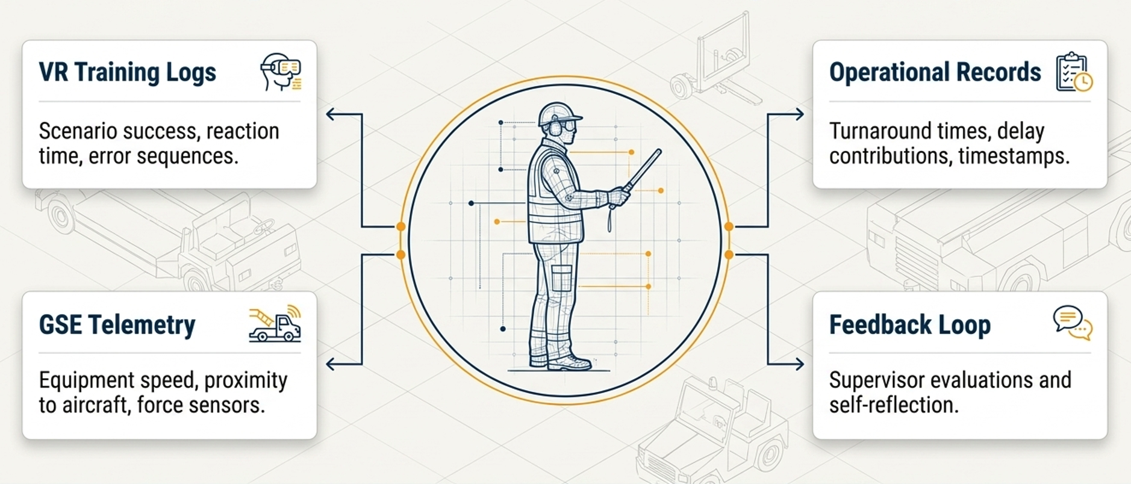
Introducing The Human-centered DT
Digital transformation
Rustam Togambayev

Slide 7
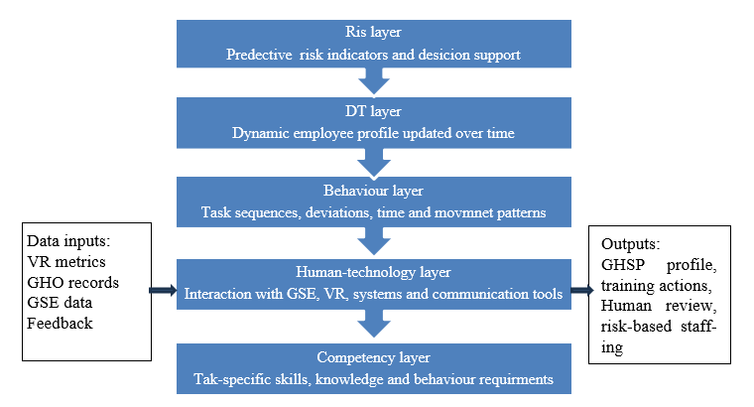
Architectural Framework
HCDT
Rustam Togambayev & Iyad Alomar
Notes:
On this slide we representing 5 tier architectural concept model where by collecting data from 3 base layers collecting information and monitoring equipment, fundamental knowledges and procedure performing acts to build DT model on forth layer and developing predicting risk layer on fifth. That architecture open path to collect and gather information and data about personnel and their performance metrics.

Slide 8
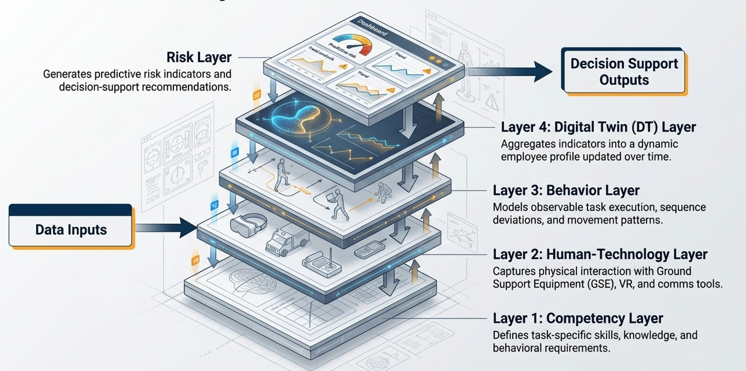
Architectural Framework
HCDT
The 5 –layer architectural Framework
Rustam Togambayev & Iyad Alomar
Notes:
On this slide we representing 5 tier architectural concept model where by collecting data from 3 base layers collecting information and monitoring equipment, fundamental knowledges and procedure performing acts to build DT model on forth layer and developing predicting risk layer on fifth. That architecture open path to collect and gather information and data about personnel and their performance metrics.

Slide 9
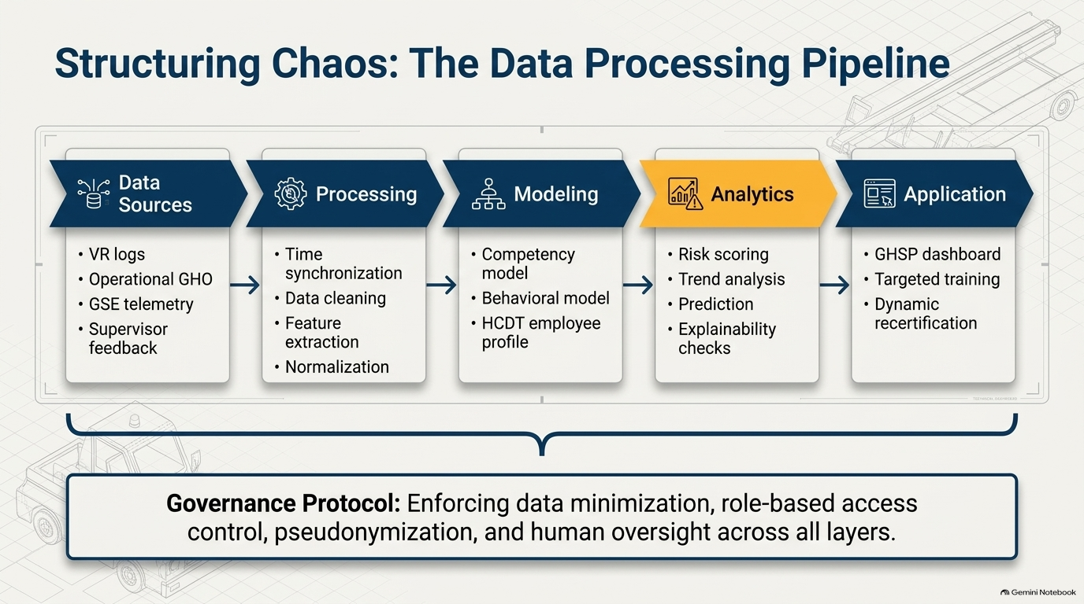
Data acquisition and aggregation
HCDT
Rustam Togambayev & Iyad Alomar
Notes:
Colleagues, This slide shows the architecture of the platform, which transforms disparate logs into a security management tool.
• Data Pipeline: We collect logs (VR, GHO, GSE), cleanse them during processing, create a digital profile of each employee and use AI to calculate risk scores and identify trends.
• Application: The output is a ready-to-use dashboard for management, which enables targeted staff training and dynamic recertification.
• Security (Governance Protocol): The end-to-end protocol shown at the bottom of the slide ensures data protection, pseudonymisation and mandatory human oversight at every stage

Slide 10
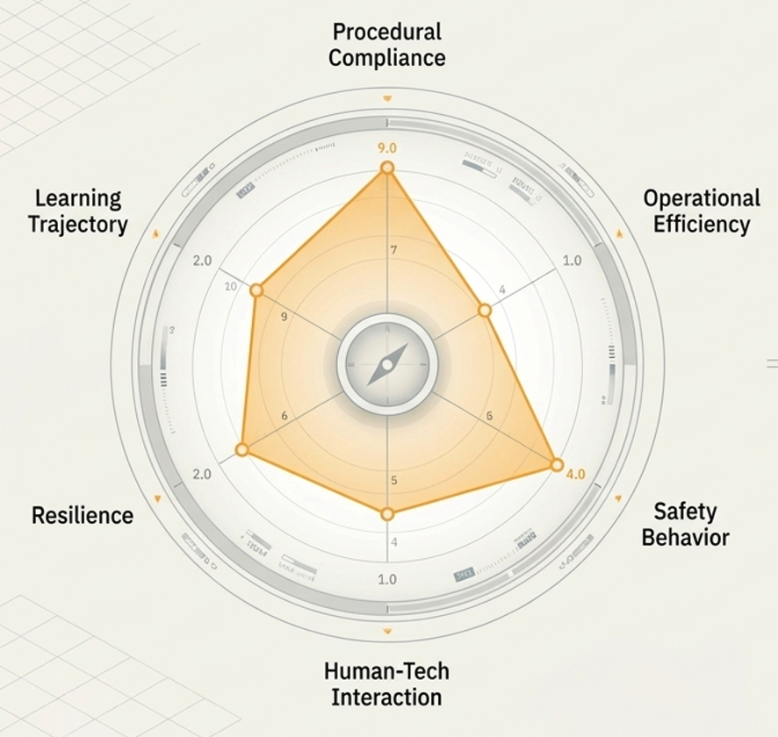
The competency model. Qualifying the Human Element
Procedural compliance
Human-tech interaction
Checklist completion, missed steps, SOP deviation) (Source: VR, , video, sensors data
GSE operation smoothness, interface/comms errors (source GSE data
Operation efficiency
Learning trajectory
Reaction time, task time, delay contribution (Source: timestamps)
Decay over time, recurrence of errors, improvement post-training (source GHSP)
Safety behaviour
Resilience
Unsafe proximity, speed deviations, hazard-zone exposure (source GSE)
Performance under abnormal weather, malfunctions, time pressure
Rustam Togambayev & Iyad Alomar

Slide 11
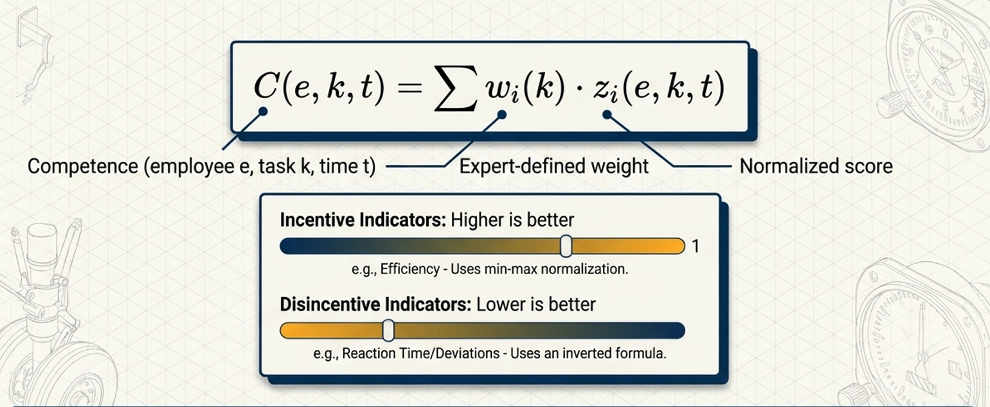
The Mathematical Engine of Competency Score
Rustam Togambayev & Iyad Alomar
Notes:
The logic regression model translates these variables into bounded highly interpretable probability of an adverse event, retaining the directional sign of coefficients so it makes easy to understand
Why risk score is high

Slide 12
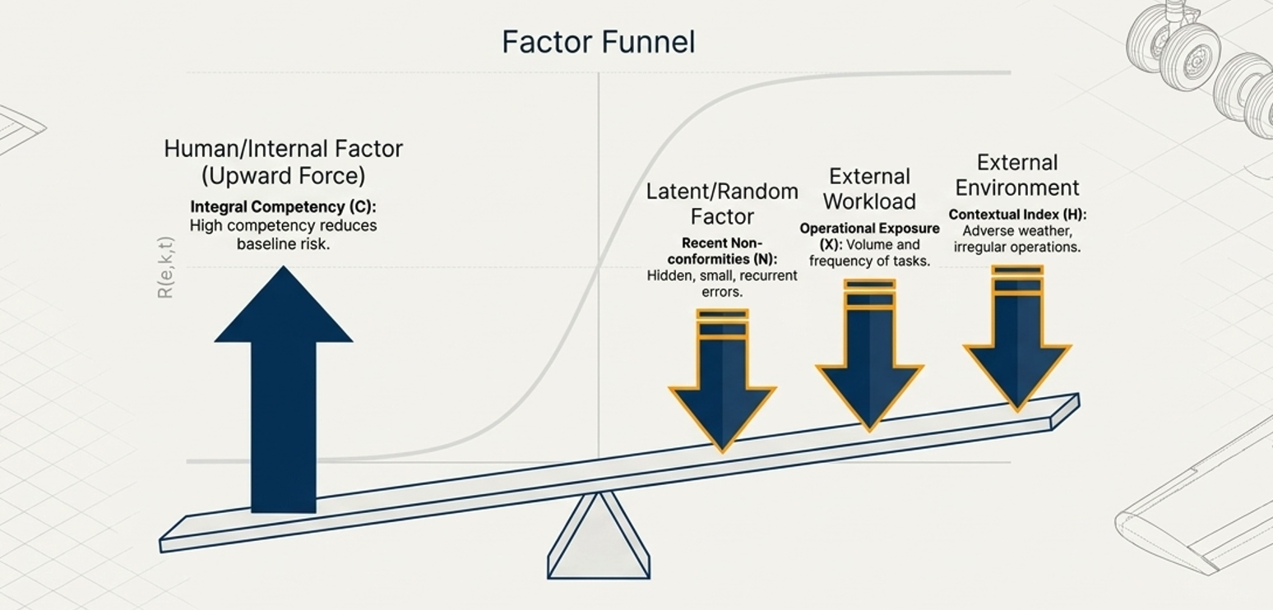
The Multidimensional Risk Prediction Model
Rustam Togambayev & Iyad Alomar
Notes:
The logic regression model translates these variables into bounded highly interpretable probability of an adverse event, retaining the directional sign of coefficients so it makes easy to understand
Why risk score is high

Slide 13
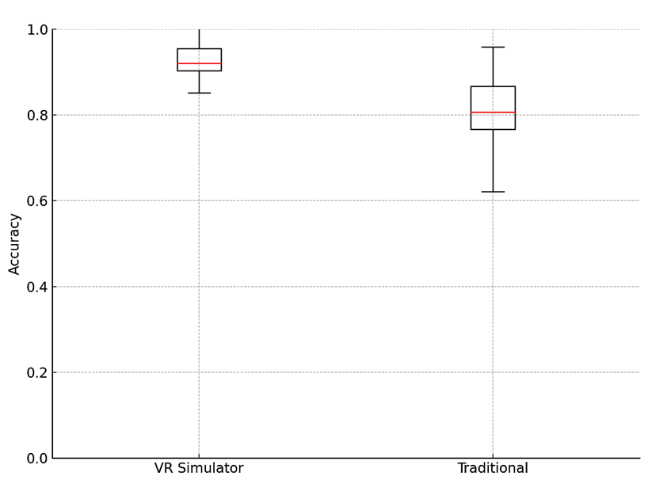
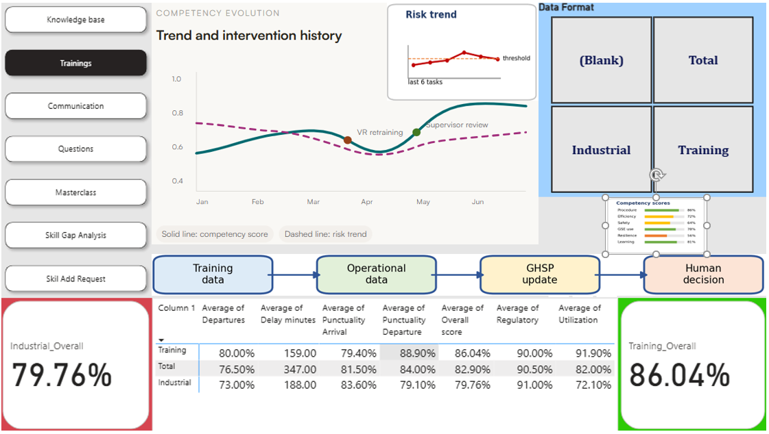
HCDT Dashboard
Rustam Togambayev & Iyad Alomar
Notes:
On this slide repress ented dashboard where collected data from different sources and translated it to a measurable entities.

Slide 14
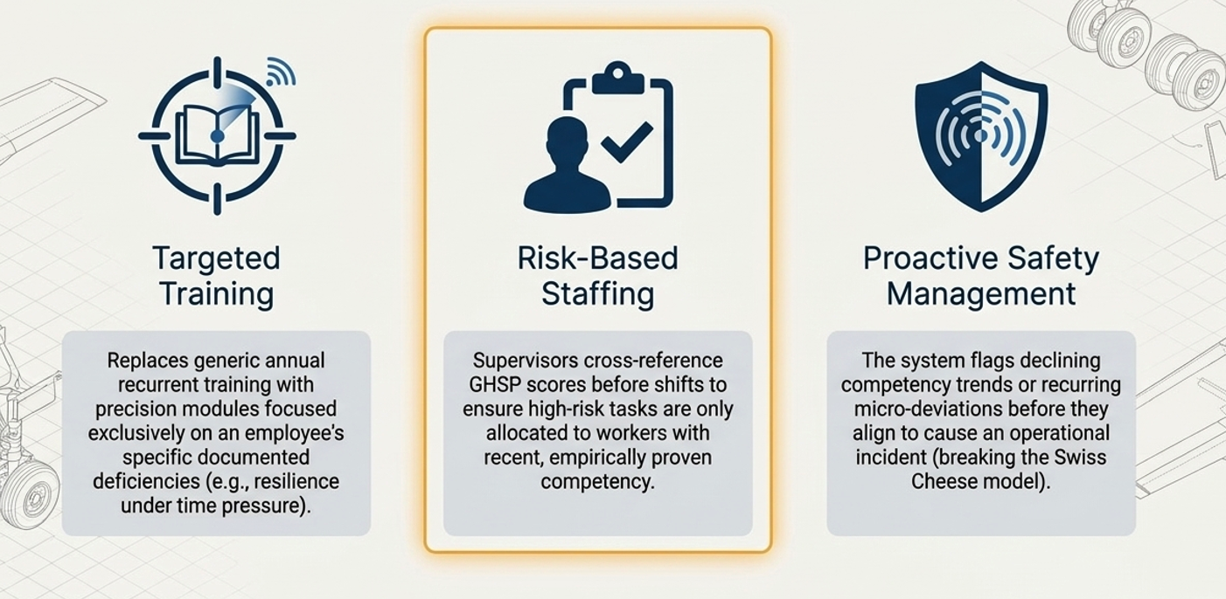
Well-considered Decisions
Precise Trainings
Rustam Togambayev & Iyad Alomar
Notes:
Based on the results obtained using the model, it is possible to work in a targeted manner to address gaps in knowledge and develop an effective curriculum

Slide 15
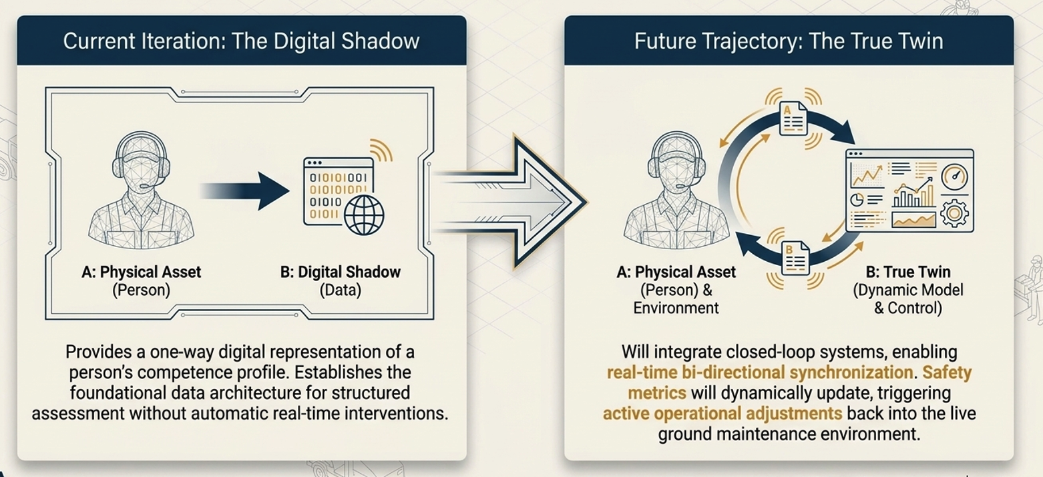
Digital Evolution
From Digital Shadow to True Twin

Slide 16
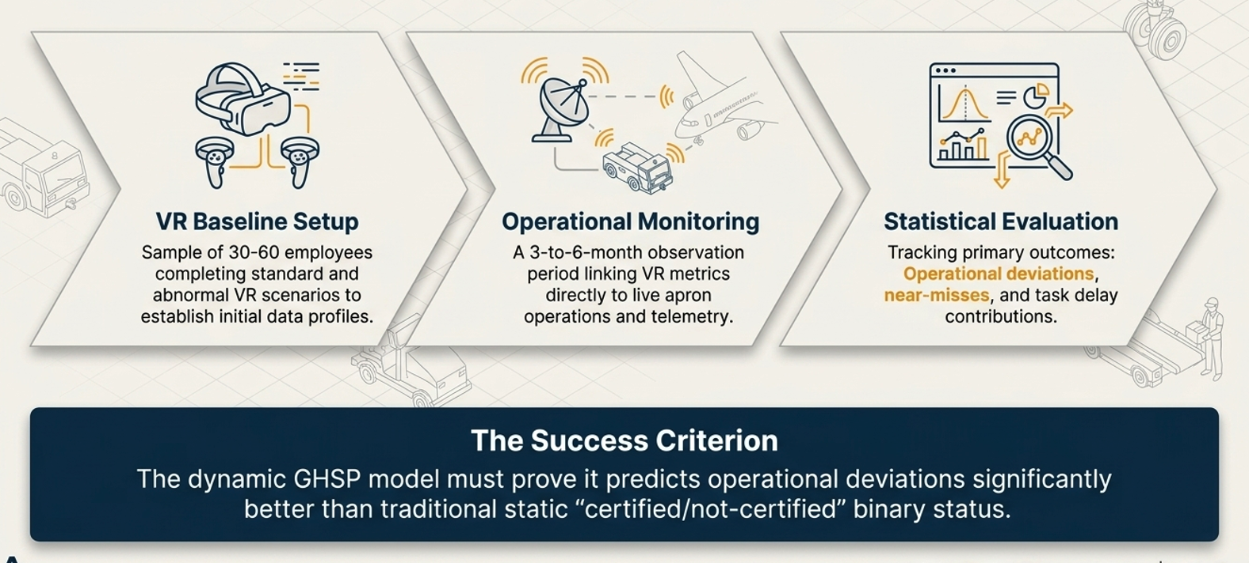
Empirical Validation Framework

Slide 17
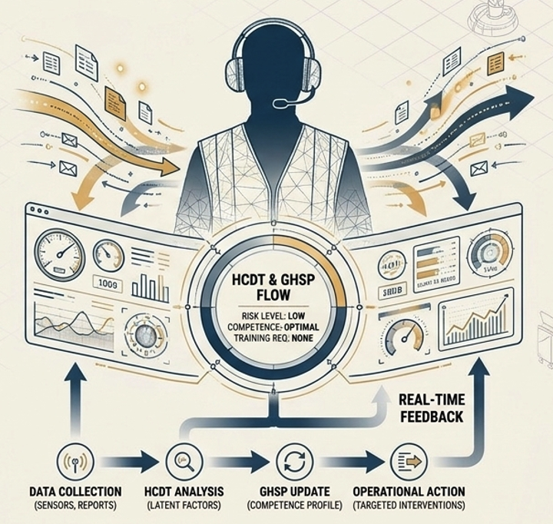
Key Findings. Secured Turnaround
Beyond Compliance
Transition GH from a rigid static certification process to a dynamic, continuous evaluation of actual competence
Holistic Mitigation
HCDT framework successfully isolated and mitigates internal (human error), latent (unrecorded deviations) and external (context/workload) risk factors
Actionable Safety
Through the GH Skills Passport, abstract predictive math is translated directly into targeted training, risk-based, and life-saving operational interventions

Slide 18
Conclusion
Successfully transitioned flight-safety certification from an outdated, static administrative checkbox to a continuous, real-time telemetry model
Built a robust data pipeline that successfully aggregates VR logs, operational timestamps, and GSE telemetry into a singular, normalized competency scale.
Mitigated the "black-box" risk by deploying an expert-weighted linear scoring model that provides full mathematical explainability for aviation auditors.
Transformed raw operational metrics into a predictive tool, identifying skill decay and systemic behavior anomalies before they manifest as costly ground handling incidents.
Rustam Togambayev & Iyad Alomar

Slide 19
Thank you for attention
Rustam Togambayev
+7 775 353 3537
r.togambayev@agakaz.kz

